Slide 1


COMPANY PRESENTATION
Virtuosity

Slide 2




COMPANY PROFILE
SUMMARY | Virtuosity is a global technology services firm that fuels growth and innovation for the modern enterprise. We bring talent and partnership to manage and execute critical business and technology initiatives.
MANTRA | “See it, Own it, Solve it!” Our clients consistently deliver MORE with LESS and consider Virtuosity a strategic advantage and trusted partner.
NUMBER OF EMPLOYEES | 160
FOUNDED SUBSIDIARIES | 2009 3
LOCATIONS | Headquartered in Bellevue, WA Development centers in Hungary and India (Chennai, Bangalore, Mumbai)
KEYNOTE CLIENTS

Slide 3
CORE SERVICES
App Dev and Sustained Engineering
Product Planning, Design, Dev
DevOps support
LIVEOPS
SYSTEM INTEGRATORS
BUSINESS INTELLIGENCE
SOFTWARE DEVELOPMENT
Software Engineering
Assessment, Gap Analysis, and Roadmaps
Modernization and Migrations
System Integration and Configuration
Business Intelligence
LiveOps
DELIVERY EXCELLENCE
TECHNOLOGY PARTNER
MATURITY MODEL
BLEEDING EDGE
EASY ENGAGEMENT
Data Consolidation, Aggregation and Migration
Reporting and Visualization
Predictive Modelling and Artificial Intelligence
AEM Development
Salesforce Development
Office 365 and SharePoint Integrations
3
©2019 Virtuosity. All Rights Reserved.

Slide 4










SOFTWARE ENGINEERING
Virtuosity leverages the efficiencies of agile software development and DevOps automation to improve productivity and increase throughput.
CAPABILITIES
TECHNOLOGIES
OUTCOMES
Application Development
Re-Engineering & Modernization
Product and Tool Development
Web Development
API and Integrations
Capacity ‘On Demand’
Shorter time to market for new features
Improved productivity and efficiency
Sustainable, scalable and reliable application lifecycle
4
4
©2019 Virtuosity. All Rights Reserved.
©2019 Virtuosity. All Rights Reserved.

Slide 5








LIVEOPS
Virtuosity improves and empowers your game or commercial operations teams' effectiveness to take bold actions with less engineering overhead.
CAPABILITIES
TECHNOLOGIES
OUTCOMES
Assessment, gap analysis, and roadmaps
Modernization & Migrations
System Integration and Configuration
Subject exerts in the Gaming LiveOps space
Reduce operational overhead
Get the most out of current and planned technology investments/resources
Ability to manage your business in a real-time environment
Reclaim employee cycles with Managed Support Services
5
5
©2019 Virtuosity. All Rights Reserved.
©2019 Virtuosity. All Rights Reserved.

Slide 6

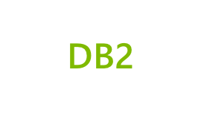








BUSINESS INTELLIGENCE AND ANALYTICS
Virtuosity solutions help consolidate and analyze business centric data from disparate sources, perform statistical analysis, build models, create visualizations to communicate the insights for decision-making.
CAPABILITIES
TECHNOLOGIES
OUTCOMES
Predictive Modeling and Artificial Intelligence
Data Consolidation, Aggregation, and Management
Reporting and Visualization
Data and Schema Mapping
Data Parsing and Migration
Valuable business insights
Performance management
Benchmarking
Data driven decision making
Accelerate ROI
6
6
©2019 Virtuosity. All Rights Reserved.
©2019 Virtuosity. All Rights Reserved.

Slide 7








SYSTEM INTEGRATION
Virtuosity ensures your technology aligns with your business objectives integrating multiple systems that cater to different functions, departments, and stages in your organization.
CAPABILITIES
TECHNOLOGIES
OUTCOMES
Content management and classification, data governance, security and availability
Content curation and Enterprise implementation
Collaboration portals and sites designed with user experience in mind
Mobile apps deployment and customization
Access to industry leading and global cloud infrastructure, content management and integrated business collaboration
Easier collaboration with teammates, partners and customers through portals and tools
Mobile business productivity by on and offline access to key data, remote workforce
7
7
7
©2019 Virtuosity. All Rights Reserved.
©2019 Virtuosity. All Rights Reserved.

Slide 8

WHAT MAKES US DIFFERENT
2
3
Talent Triad
Our resources bring a combination of leadership, technical know-how and strategic business management expertise to each engagement.
Experience/Referenceable
The three biggest technology companies in the world are our clients!
1
4
Technology Stack
Global technology certification(s)
Platform agnostic
Bleeding edge
Ease of Engagement
Agile and open engagements models backed by Guarantees.
5
Diversity & Inclusion
We maximize an untapped talent pool to further our talent and ideation.
©2019 Virtuosity. All Rights Reserved.

Slide 9
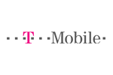



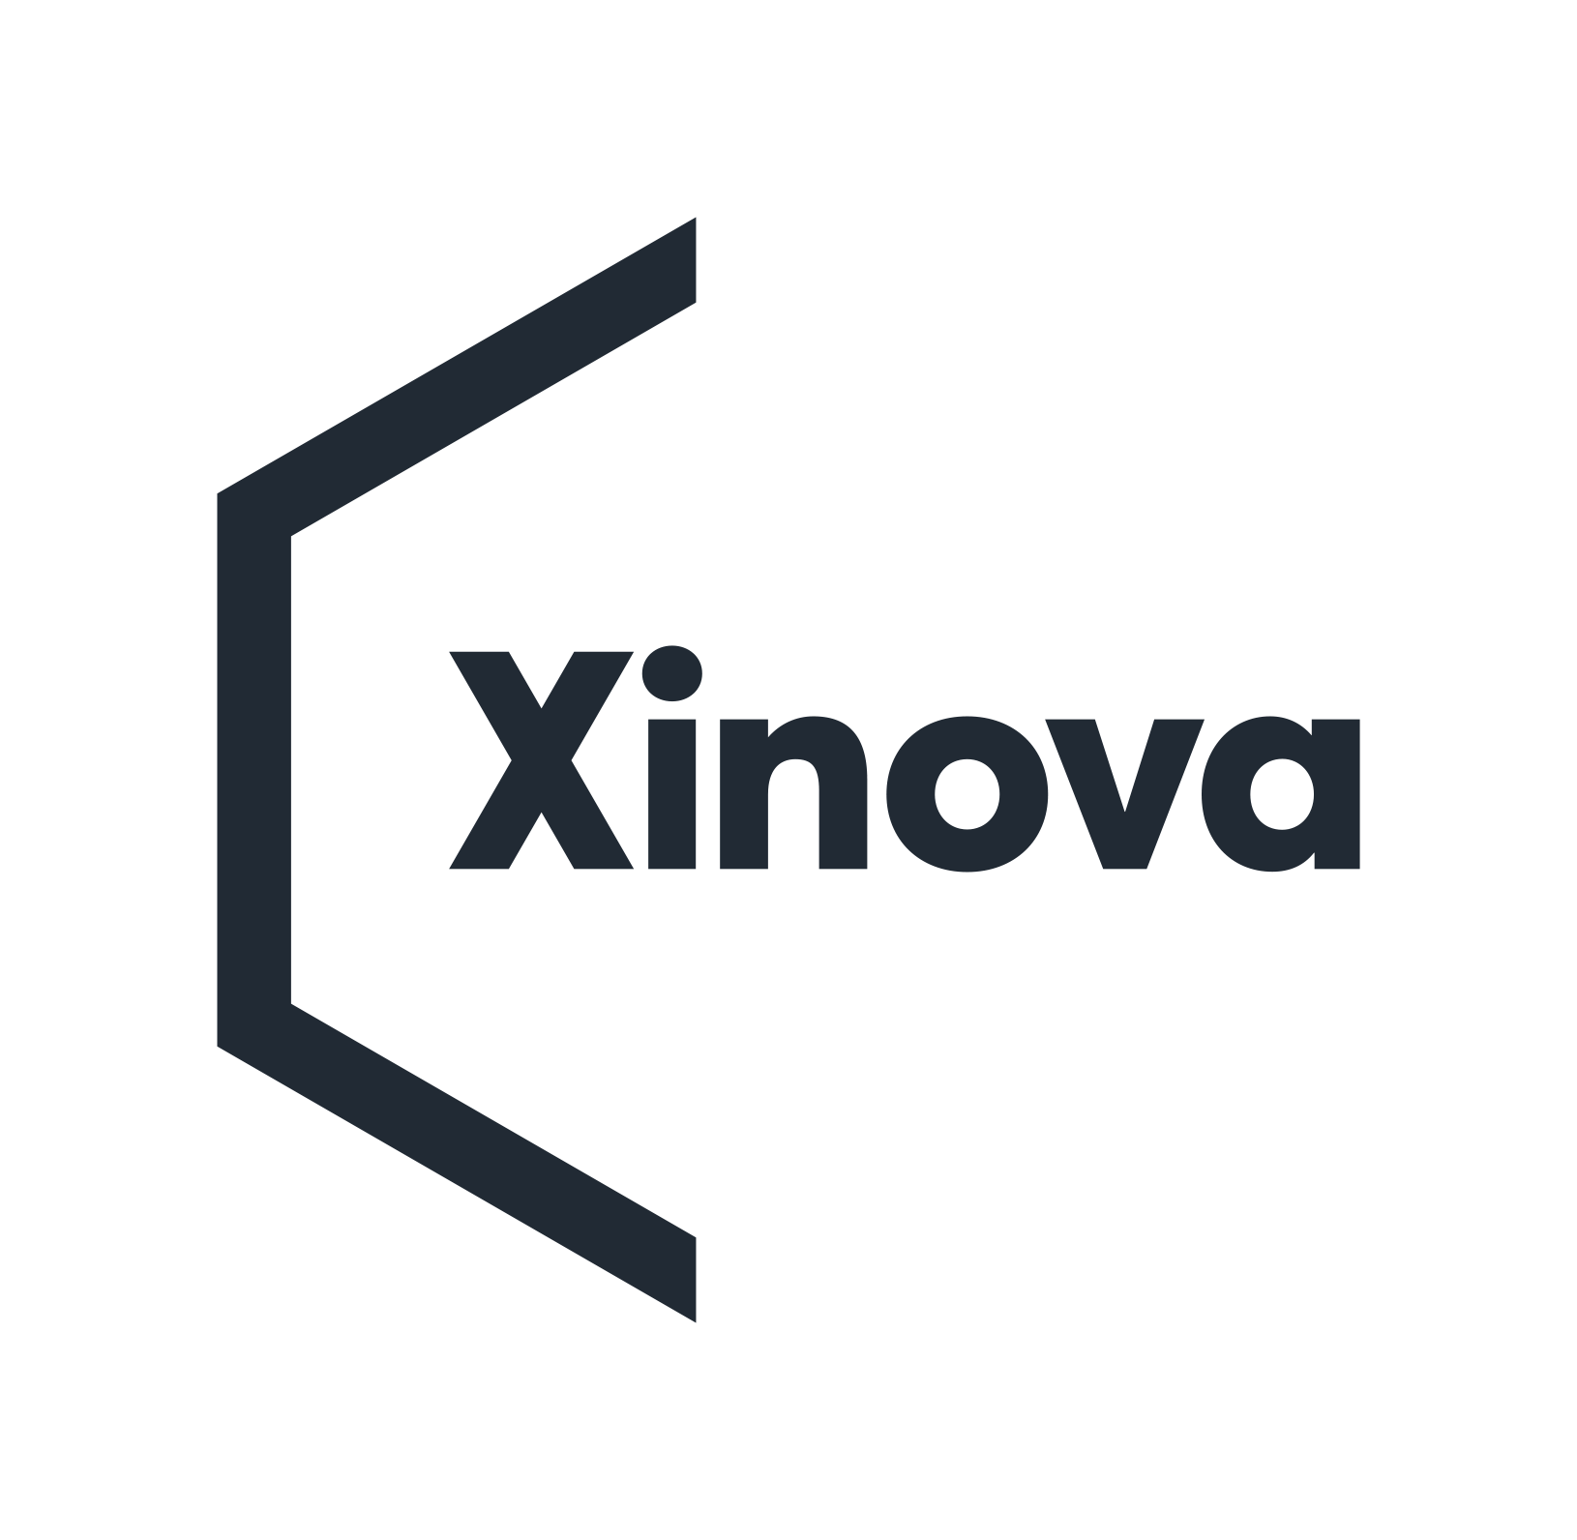









CLIENTS
Minecraft:
“Virtuosity has become our strategic ally to enable scale, execution, and maturation of the platform behind Minecraft. We rely on their rare combination of game development experience, release management and DevOps, and strategic program leadership to shepherd all our critical development initiatives."
- Partner, Minecraft -
Avalara:
“Virtuosity continues to be our go-to strategic partner in maintaining and supporting our AEM platform. They helped us migrate from a legacy CMS system and have exceeded our expectations in helping us leverage our AEM platform to its fullest potential.”
- Director of Marketing Web Tech-
Microsoft Azure:
“We trust and rely on Virtuosity to manage and evolve our release management processes across our entire portfolio. Their consistent quality, velocity, and programmatic approach is top notch and we view them as an extension of our team.”
- CVP, Azure Data –
Some of our great clients
©2019 Virtuosity. All Rights Reserved.
Notes:
9

Slide 10
COMPANY EVOLUTION & MILESTONES
2009 Withincompliance LLC founded as a software release compliance staffing company
2015 Renamed Virtuosity Consulting to reflect market breadth of service offerings
2017-2018 Rapid Growth; Three additional Development Centers brought online
2011 Organic expansion of project & service offerings; Increased number of clients and revenue 3X
2017 Core focus on software development services; Chennai Development Center opened
2019 25 active engagements across 11 enterprise clients
10
10
©2019 Virtuosity. All Rights Reserved.
©2019 Virtuosity. All Rights Reserved.

Slide 11

VALUES
“See it, Own it, Solve it!”
EMPLOYEE
Be Innovative: seek continuous improvement, iterate, and fail fast.
Be Gritty: resolve and persistence.
Be Relevant: stay closely connected and to the point
Be Cool: have fun while being the best
COMPANY
Partnership: invest in long-term joint success with our customers
Innovation: creative and new approaches, solutions, and outcomes in solving business problems
Execution: increased speed to market with high quality deliverables and methodologies
Flexibility: continuously adapt to best serve our customers, associates and partners

Slide 12


SUMMARY/RESOURCES
VIRTUOSITY 360
Access to all of the artifacts and resources.
Virtuosity Website – https://virtuositycg.com
Virtuosity Github (Case Studies and Projects) - https://github.com/virtuositycg
Virtuosity Videos:
Software Development in 90 seconds - https://vimeo.com/226773861
Release Management in 90 seconds - https://vimeo.com/226773712
Virtuosity in 90 seconds - https://vimeo.com/133603135
©2019 Virtuosity. All Rights Reserved.

Slide 13

CONTACT INFORMATION
Brent Lazarenko
Managing Partner
15375 SE 30th Place #100 Bellevue, WA 98007
425.999.4044
brentl@virtuositycg.com
www.virtuositycg.com
©2019 Virtuosity. All Rights Reserved.

